Slide 1
Imagery for email headers – screen cap the image (snipping tool)
PC: Windows + Shift + S
Mac: Shift + Command + 4
Main title text – More More
Subtitle text – More More
Session
Organizers:
Pic
Pic
Pic
Pic
Pic
Pic
Pic
D/G/F Name
Name Name
Institution
Name Name
Institution
Name Name
Institution
Name Name
Institution
Name Name
Institution
Name Name
Institution
Name Name
Institution
Submit Abstracts to: https://avs71.avs.org
Find more promotion materials and templates here: https://avs71.avs.org/promotion/
Find more D/G/F-specific promotion material here: https://www.dropbox.com/scl/fo/eow306v1rm9so5bi6tc8d/AOu73wt9EUN3KgrJ_sVnrpM?rlkey=yqun2pl6ho0keqz7pwhs44thk&st=1rvt1tci&dl=0
More questions / help, contact Della Miller: della@avs.org

Slide 2
What needs to be edited
If you don’t want all caps, click text and go to Format > Font, and turn-off “all caps”
Put in your title
Can also get from: LINK
Main title text – More More
Subtitle text – More More
Session
Organizers:
Pic
Pic
Pic
Pic
Pic
Pic
Pic
D/G/F Name
Name Name
Institution
Name Name
Institution
Name Name
Institution
Name Name
Institution
Name Name
Institution
Name Name
Institution
Name Name
Institution
Submit Abstracts to: https://avs71.avs.org
You might add your specific link here
Add pictures (see next slide), and put in names and institutions.
Put in your DFG Name
Feel free to adjust text sizes and locations to fit your needs.
Be creative if you want!
Main colors used in advertisement, these colors should be available as “recent colors” in this pptx file

Slide 3
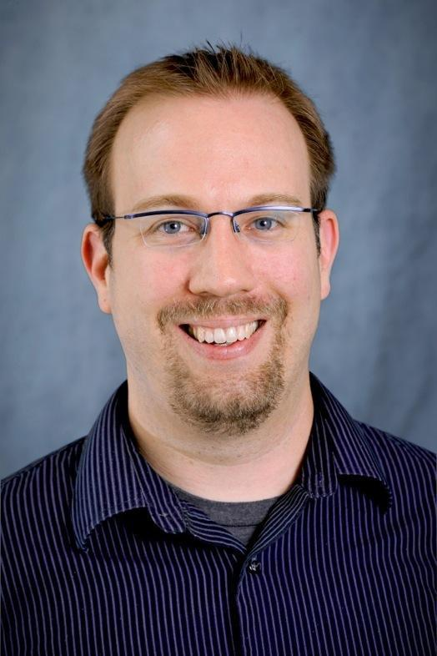
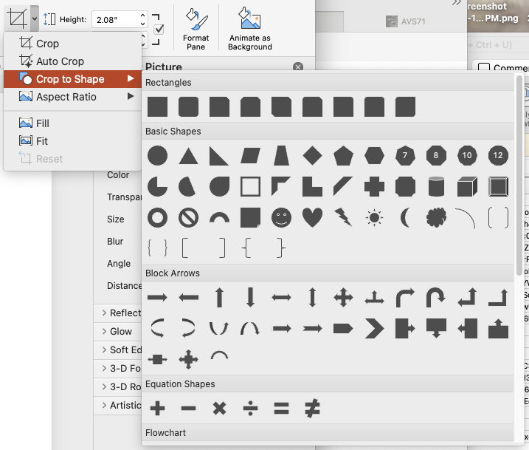
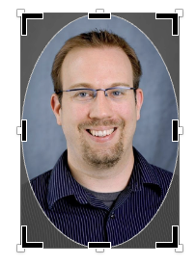
How to circle crop an image/photo in PowerPoint
Find colleague’s image on internet!
(a professional one please! 😁)
Copy-paste into PowerPoint.
Double click on image to pull up the picture format pane and find the crop tool →
Click the ”crop to shape” and choose the circle
If an oval, then click off image and then double click on image again. Then just click on the crop tool again (you do NOT need to choose dropdown now). This time, you should be able to crop with the circle.
Now, when you crop, you will see dimensions for width and height, just make them the same (so it is a circle or pretty close). You can also grab image and shift around to center it in the circle.
Lastly, to get it to the correct size for advert, double click on image again, and use the shape size panel. Height to 0.65 inches (or 1.65 cm)
Hit this dropdown!
Oval, not a circle!
When you choose crop should be able to crop like this
Set height to 0.65” or 1.65 cm

Slide 4
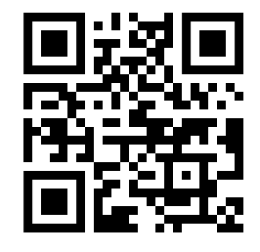
Imagery for Social Media Posts –
Screen cap this image (snipping tool)
PC: Windows + Shift + S
Mac: Shift + Command + 4
D/G/F Name
Main title text – More text
Subtitle text – More More
Session
Organizers:
Pic
Pic
Pic
Pic
Name Name
Institution
Name Name
Institution
Name Name
Institution
Name Name
Institution
Pic
Pic
Pic
Name Name
Institution
Name Name
Institution
Name Name
Institution
Submit Abstracts to: https://avs71.avs.org

Slide 5
Imagery for Social Media Posts
You might add your specific link here
D/G/F Name
Main title text – More text
Adjust text sizes so not bigger than width of main image up top.
Replace with pictures, names, and institutions
Subtitle text – More More
Session
Organizers:
Pic
Pic
Pic
Pic
This is a general QR code to AVS71, you might also want to make one directly to your division submission webpage. I use https://www.qr-code-generator.com and then just screen cap the QR rather than make an account…but choose whichever you prefer.
Name Name
Institution
Name Name
Institution
Name Name
Institution
Name Name
Institution
Pic
Pic
Pic
Could change to your specific D/G/F webpage call.
Name Name
Institution
Name Name
Institution
Name Name
Institution
Submit Abstracts to: https://avs71.avs.org

Slide 6
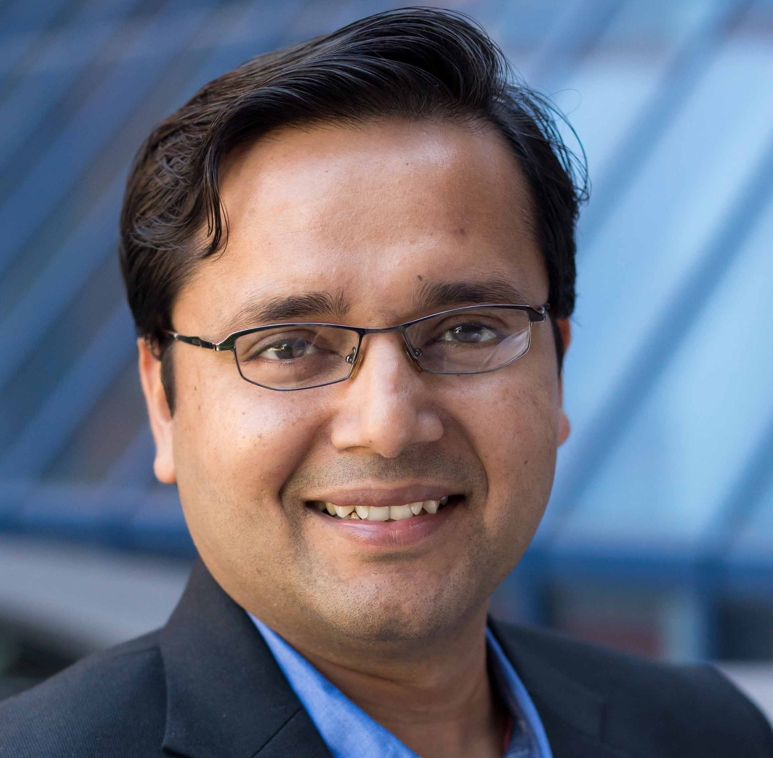
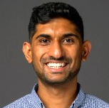
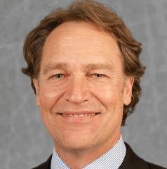
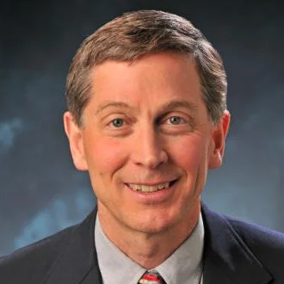
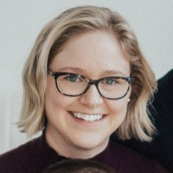
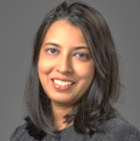
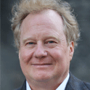
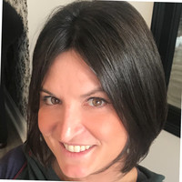
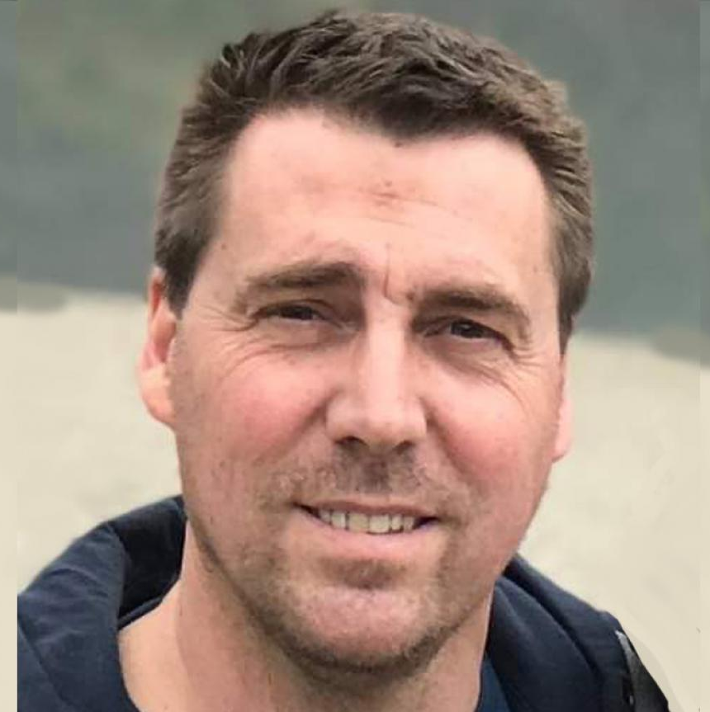
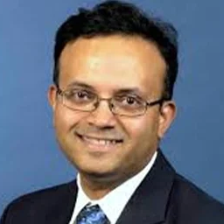
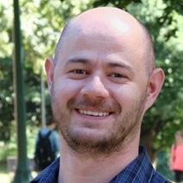
EXAMPLES
Atomic Scale Processing for
Thin Film Formation & Patterning
Session
Organizers:
Thin Film Division
Adrie Mackus
TU/e
John Conley
Oregon State
Bharat Jalan
U. Minnesota
Ashley Bielinski
Argonne
Sagar Udyavara
Lam Research
Greg Parsons
NC State
Steve George
U. Colorado
Submit Abstracts to: https://avs71.avs.org/division-tf
Thin Film Processing for
Microelectronics & Advanced Packaging
Session Organizers:
Thin Film Division
Sarah Atanasov
Intel
Devika Choudhury
ASM
Elton Graugnard
Boise State
Robert K. Grubbs
IMEC
Jessica Kachian
Kokusai
Christophe Vallee
Albany
Erin Cleveland
NRL
Parag Banerjee
UCF
Stephen McDonnell
U. Virginia
Submit Abstracts to: https://avs71.avs.org/division-tf
NOTE: For big divisions/groups that have multiple sessions, you can split up into your session names, like above. Still, might need to go to two rows of pictures; be creative.

Slide 7
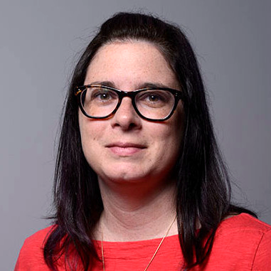
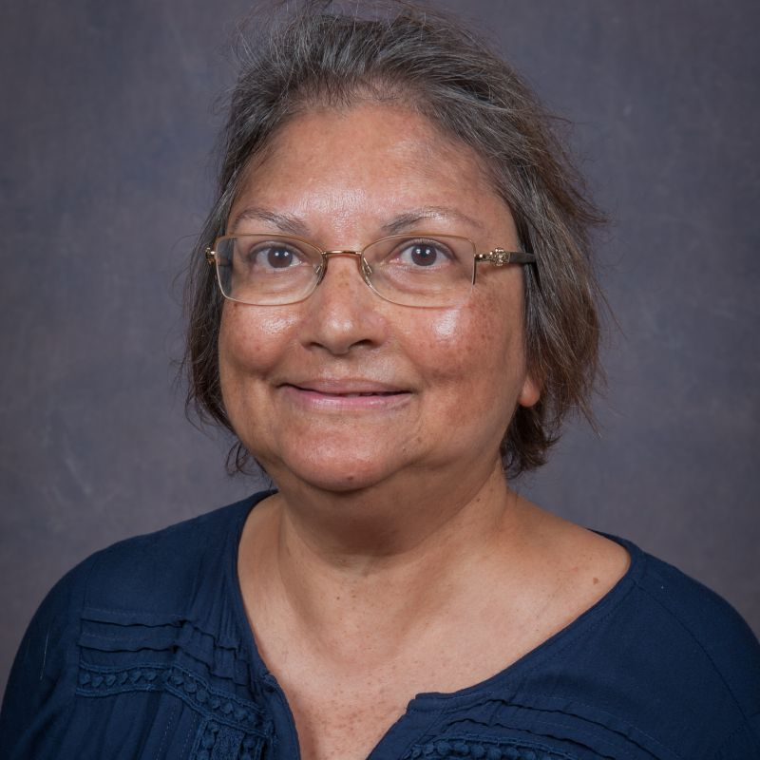
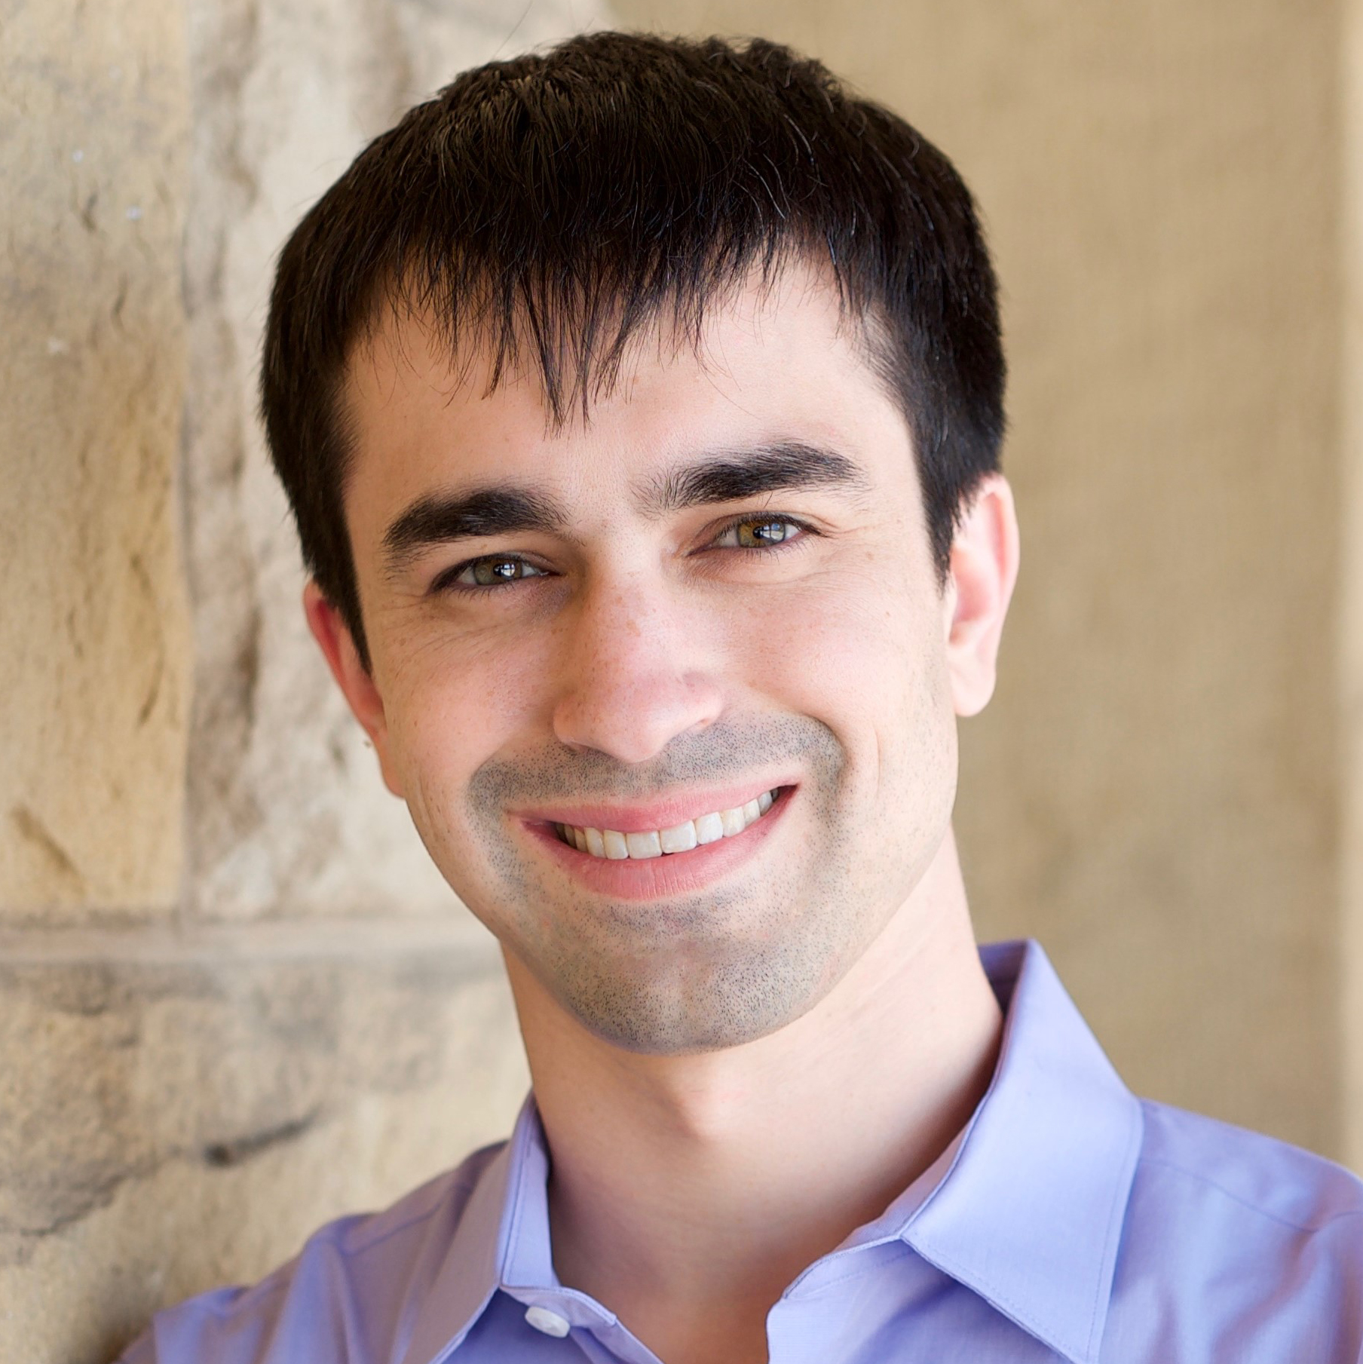
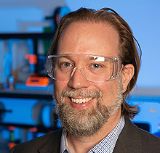
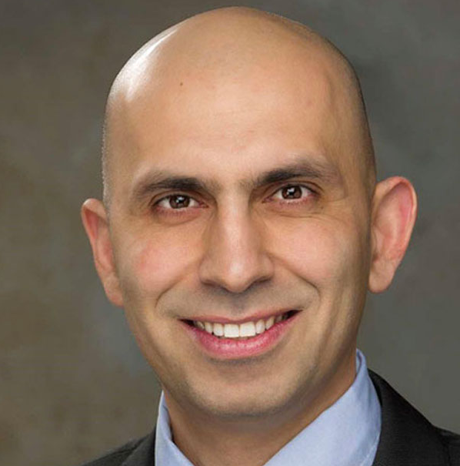
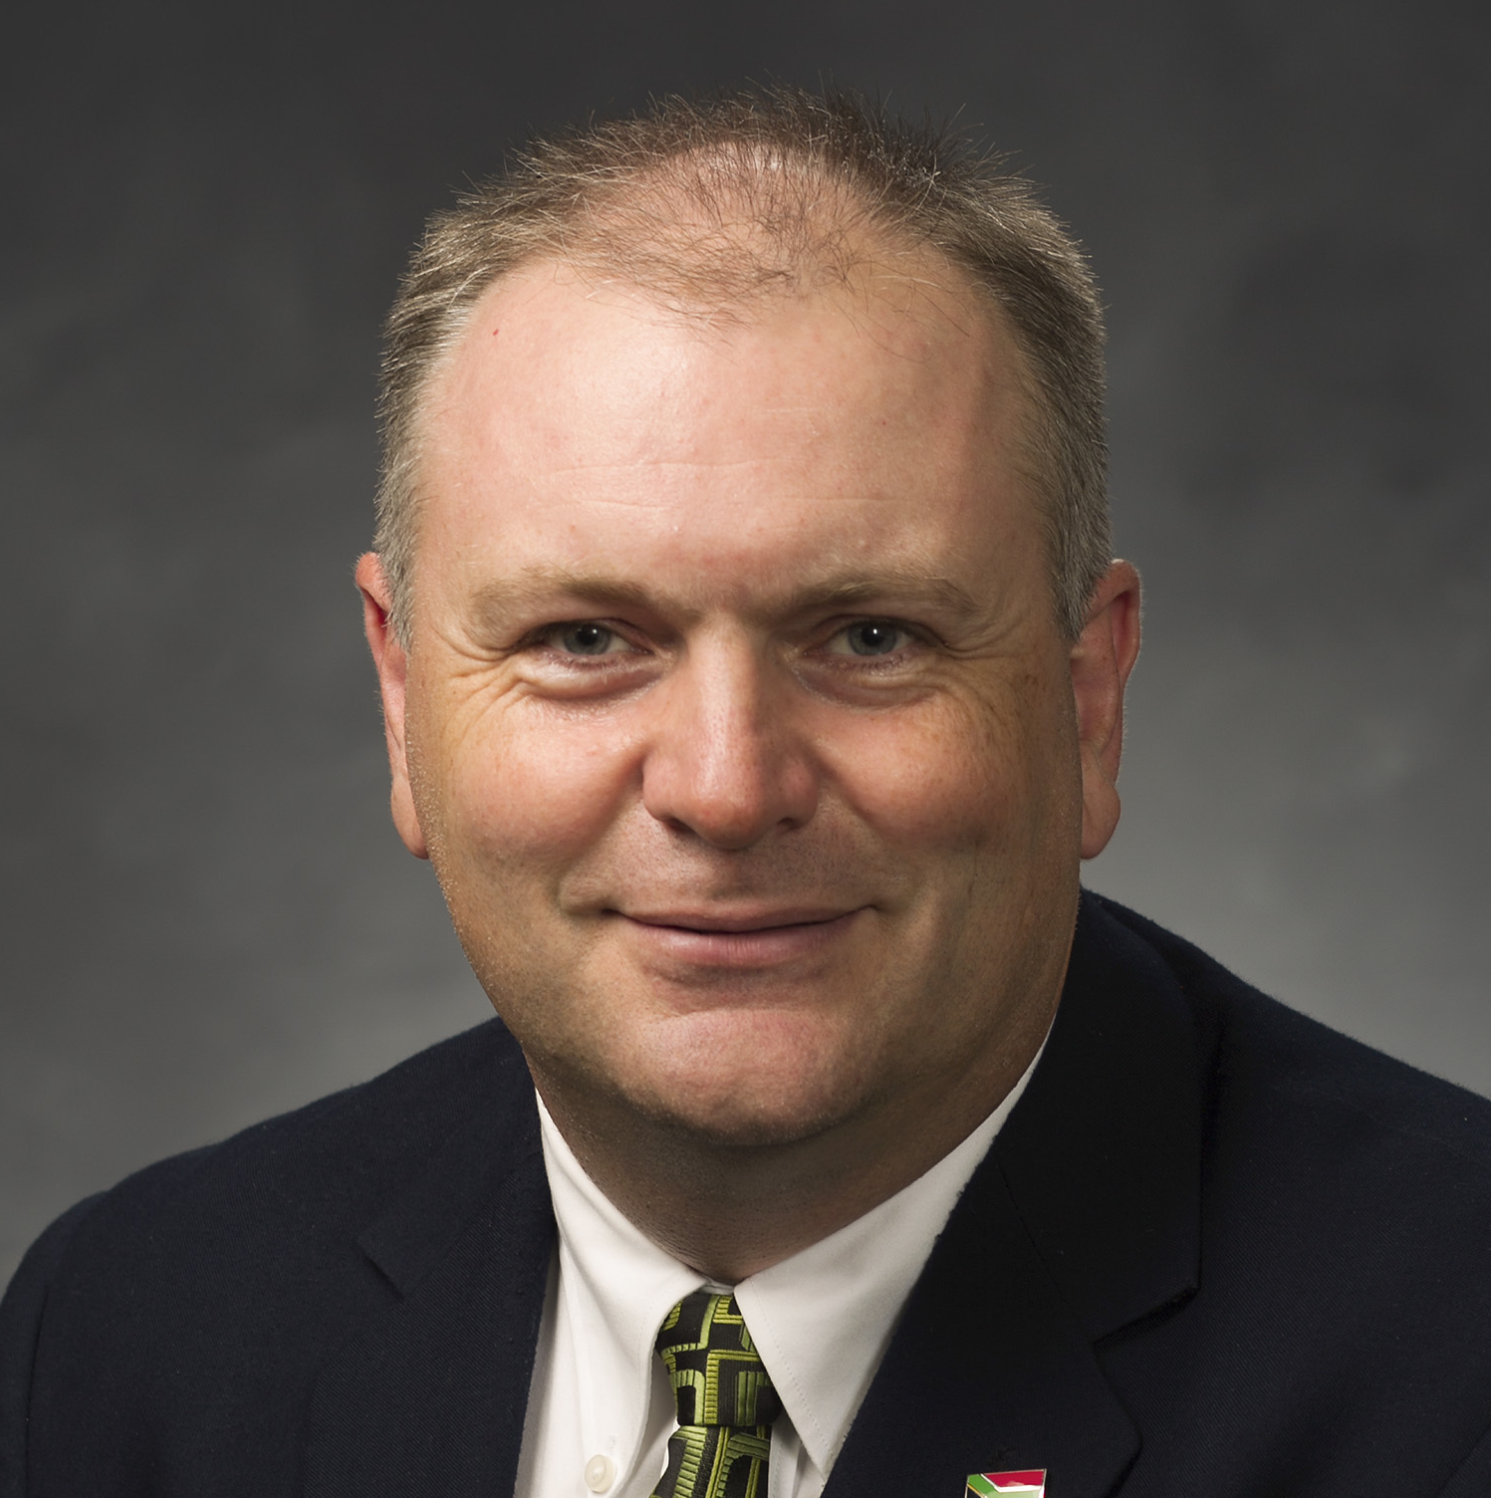
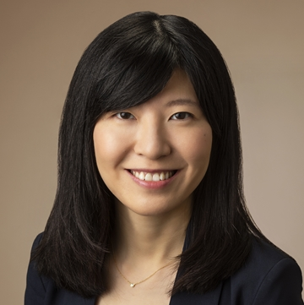
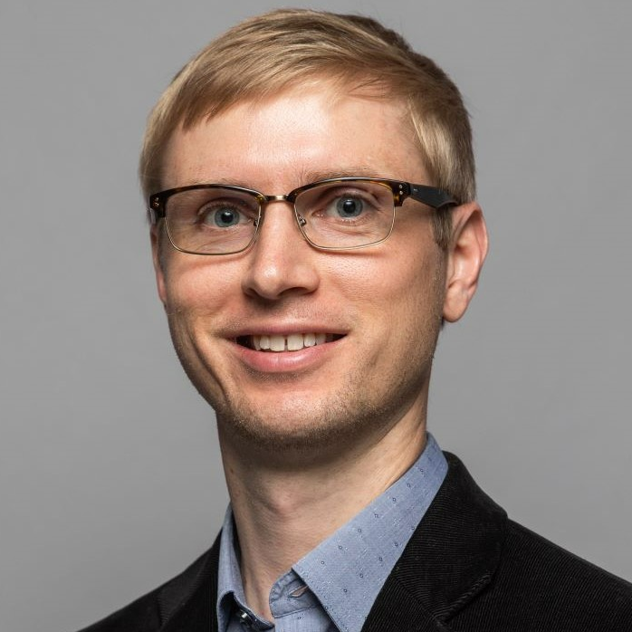
EXAMPLE
NOTE: For big divisions/groups, might need to wrap pictures around side as well? Be creative.
Thin Film Division
Thin Film Division
Emerging Applications of Thin Films:
Energy, Sustainable Systems, and Extreme Environments
VSHOP 2025
Vapor Synthesis of Hybrid, Organic, & Polymeric Materials
Session
Organizers:
April Jewell
JPL
Su Gupta
U. Alabama
Blake Nuwayhid
NRL
Session
Organizers:
David Bergsman
Washington
Mark Losego
Georgia Tech
Siamak Nejati
Nebraska
Lauren Garten
Georgia Tech
Joe Becker
KJLC
Richard Vanfleet
BYU
Rong Yang
Cornell
Matthias Young
Missouri
Junjie Zhao
Zhejiang
Submit Abstracts to: https://avs71.avs.org/division-tf
Submit Abstracts to: https://avs71.avs.org/division-tf

